Slide 1
Gestalt Principles
By Corey Crooks

Slide 2
Gestalt overview (University of Hawai'i, n.d.)
Gestalt principles detail a number of different looks into human perception in design elements.
Gestalt principles are made from a number of different minds, and not any one particular theorist.
Gestalt principles strive to explain a number of ways the human mind constantly looks to connect and associate content that may sometimes be unwanted.

Slide 3
Gestalt overview (University of Hawai'i, n.d.)
Different Gestalt laws provide a sense of direction while developing application interfaces
Designers may use the information within the laws themselves to help understand how users may approach their design philosophies.
Understanding these laws may help eliminate potential issues rooted in design philosophies.
Gestalt laws are not definitive, and are not guaranteed for every person that uses an interface. These “laws” are to be taken as subjective material.

Slide 4
Gestalt Example 1: Proximity (Hanover College, n.d.)
The Law of Proximity details physical space between elements.
Elements that are closer to each other will be perceived as a grouping.
This law alone does not require similar elements.
The law remains true should elements be visually distinct, as defining the similarity between elements is described by an entirely different law.
Increasing the space between elements provide distinction.
Elements that are spaced apart from a grouping can provide a distinction and highlight lone elements.

Slide 5
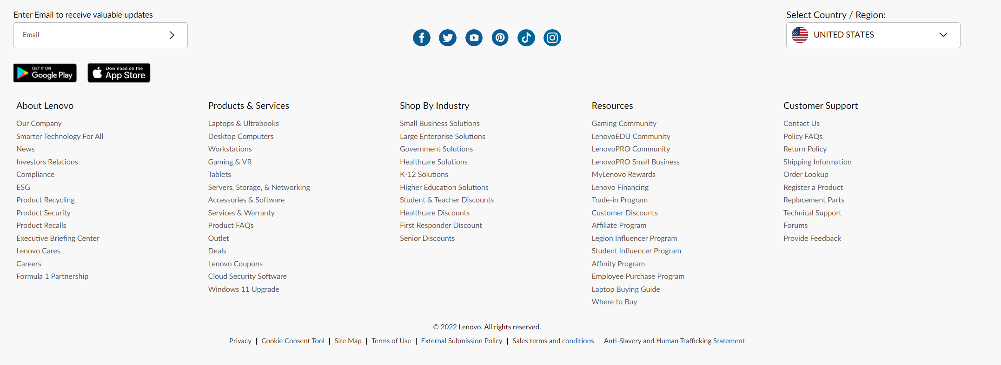
Proximity from Lenovo (Lenovo, 2022)
Elements as part of a list are
seen as a unified group.
Products and Services is
distinct from Shop by Industry
due to the spacing between lists.
Social media icons are seen as similar elements in part due to the spacing and grouping of each icon in the list.

Slide 6
Gestalt Example 2: Similarity (Hanover College, n.d.)
The Law of Similarity describes how similar elements may be grouped together.
Particularly, elements that are visually similar may often times be associated together by the user.
This could happen despite the functionality of these elements like a button and tab indicator being visually similar.
This may lead to confusion from unifying design language, should functionally different elements present visually similar to one another.

Slide 7
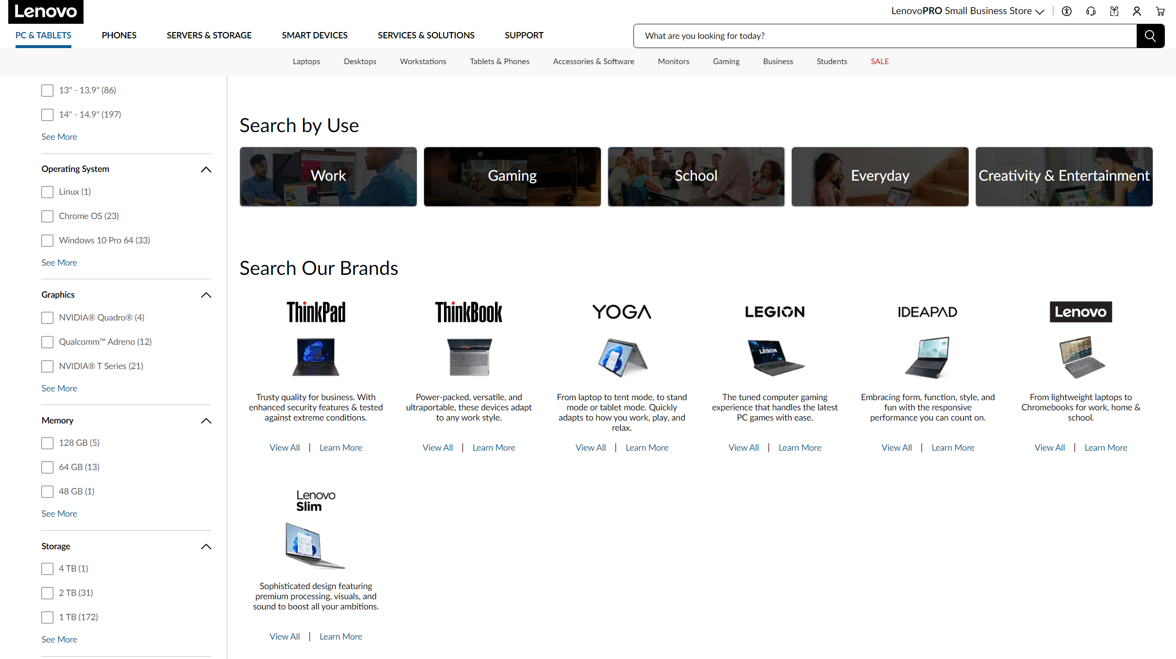
Similarity from Lenovo (Lenovo, 2022)
Search by Use buttons found on the Lenovo page are visually distinct from the “Search Our Brands” list.
This provides a clean way to distinguish more broad categories from that of more selective ones such as use cases vs specific product lines.

Slide 8
Gestalt Example 3: Closure (Washington State University, n.d.)
The law of closure depticts how humans perceive blank space between lines and points to fill in information.
By this law, a horizontal series of dots and lines may be perceived as a straight line.
This law deals with the human tendency to fill in blank spaces with extrapolation.

Slide 9
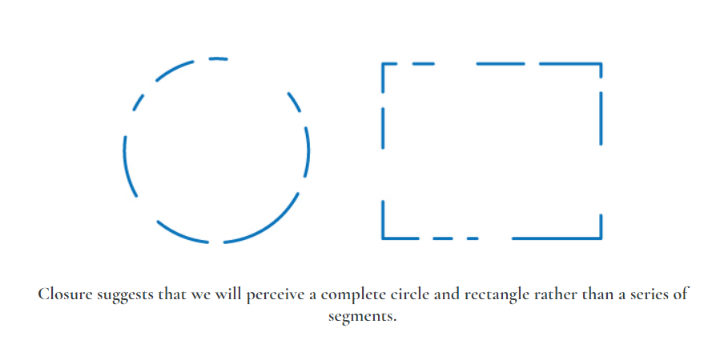
Closure from WSU (Washington State University, n.d.)
Seen below, this law is shown to illustrate how humans may perceive shapes based on an incomplete outline.
The example below shows a circle and square respectively with missing information that may be filled in by regular human cognitive functions.

Slide 10
What makes an application easy to navigate?
An application that is easy to navigate gives the user control where necessary.
The user may be able to navigate to deeper sections of an application or website with ease by using related lists like drop-down lists to show embedded choices and information.
This may eliminate the need to have a user load multiple webpages in succession to get to a single place, and speed up navigation.
It also must be succinct where appropriate.
The user must have options available to them, but too many options can be cumbersome.
It may be best to group similar pages together in order to minimize the analysis the user must do throughout the application.

Slide 11
What also makes an application easy to navigate?
The application must be consistent.
Should an application show design language that differs from that which is previously used, the user may become frustrated with the overall design.
For example, using a text styling that looks visually identical to a button may leave the user frustrated when the simple text has no click functionality to it.
Information in the application must be where the user expects.
Information or navigation tools that stray from where the user would reasonably expect to see them may provide for a frustrating user experience.
Would you applaud a website for having the navigation bar halfway down the webpage in the middle of the body?

Slide 12
Screen Real Estate
Screen Real Estate refers to the positioning of elements with regard to the space on a user’s screen.
Applications with decent use of screen real estate may utilize elements that enhance the user experience with both functionally pleasing navigation/informational tools, and aesthetically pleasing blank space (or also known by ‘whitespace’)
Elements must act coherently with the space given in order to remain functional and logical with the restrictions set by the screen.

Slide 13
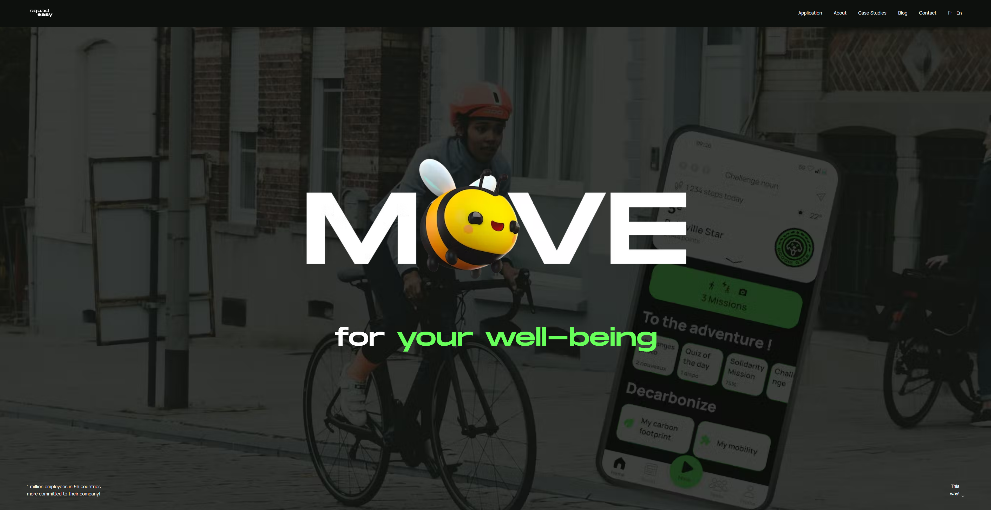
Screen Real Estate Good Use
https://www.squadeasy.com/en/
The Squad Easy website presents screen real estate very well.
On the home page, user’s see up front what the Squad Easy goal is.
Users may use the on-screen text, navigation tools, and selected background images to quickly gather information on the Squad Easy mission
It is immediately apparent that this functions as an app-focused mobility platform for health and environmental impact improvement just by what is presented on screen to the user, with minimal space that is not being utilized in some fashion.

Slide 14
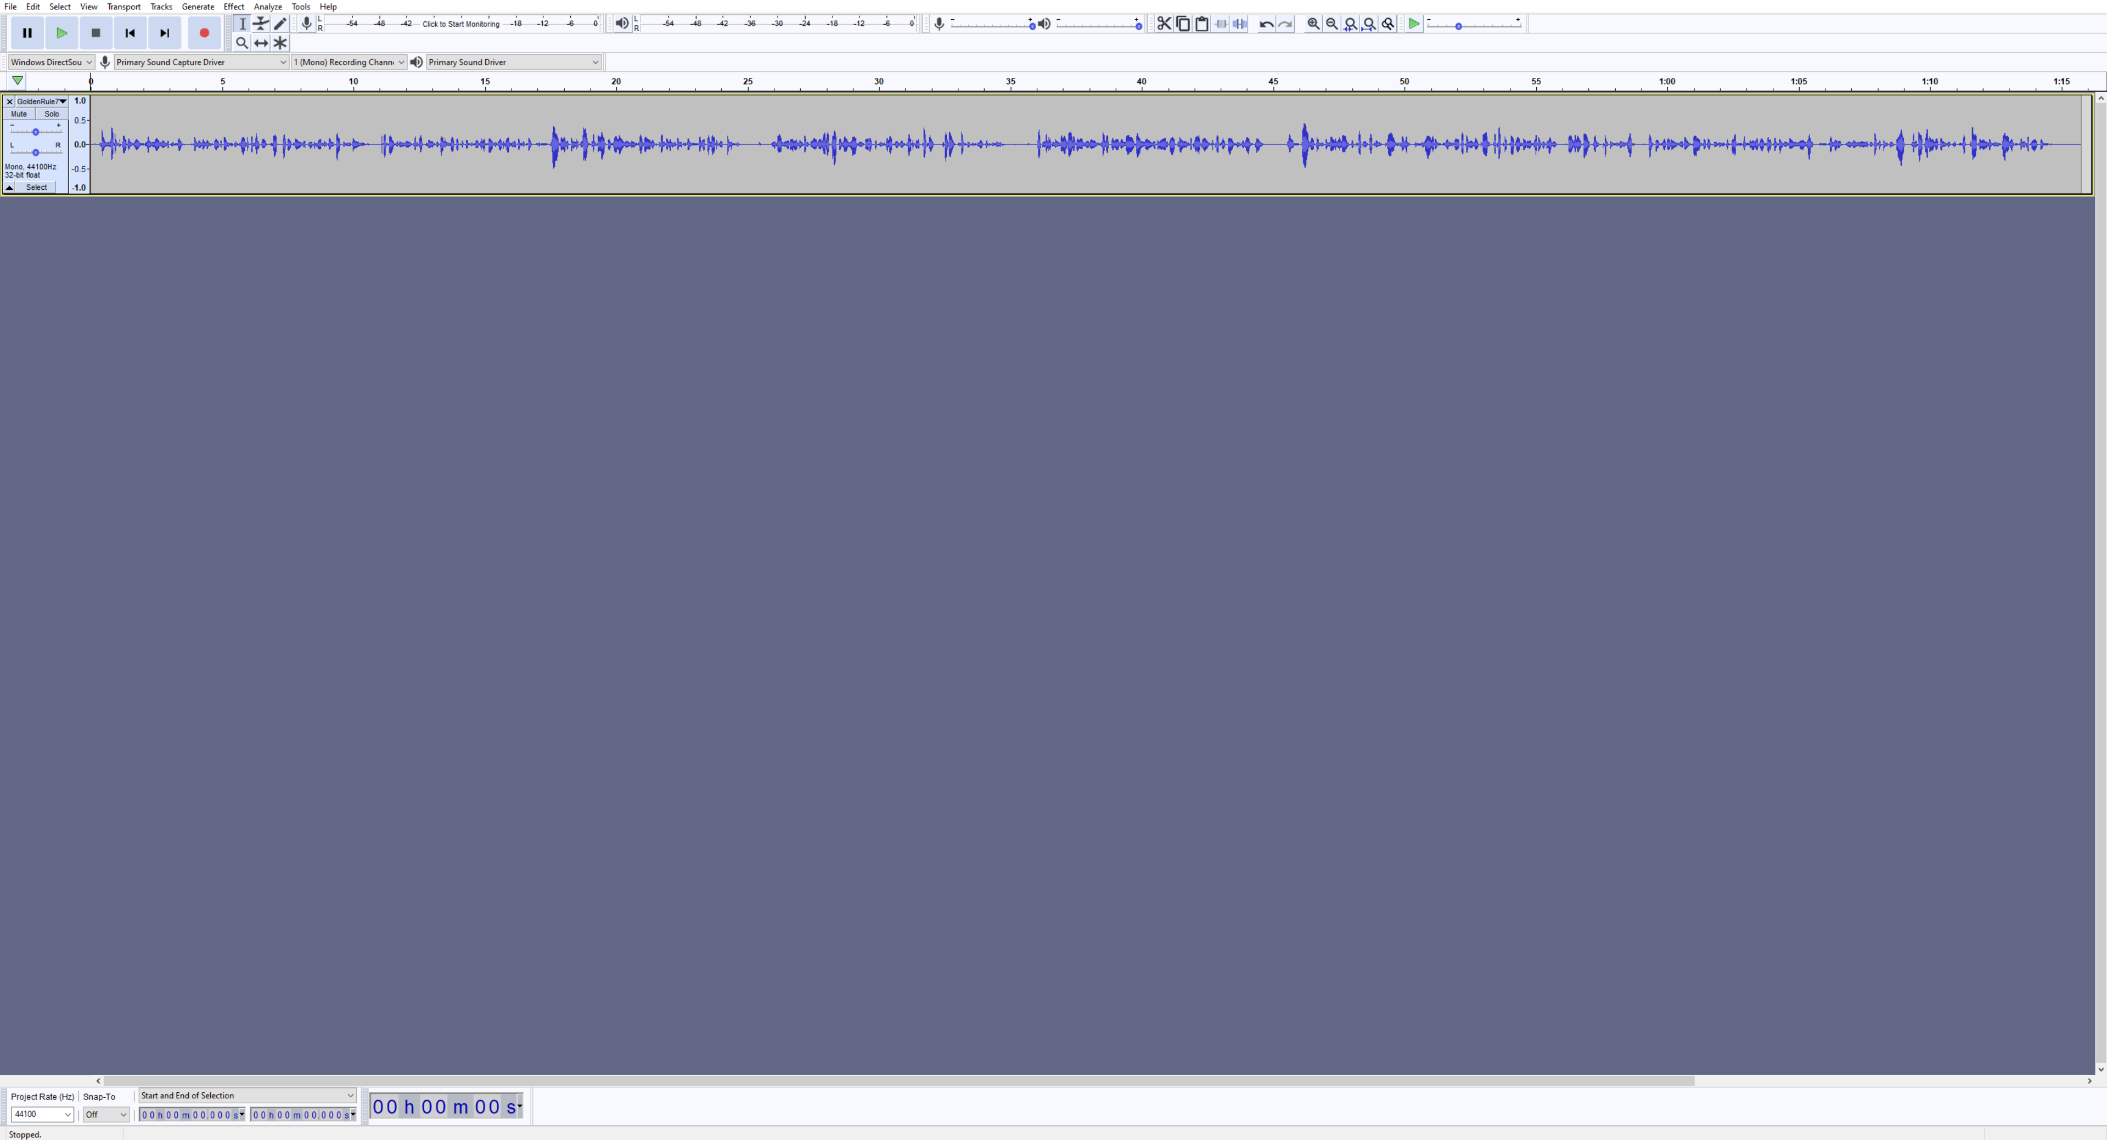
Screen Real Estate Poor Use: Audacity
As seen below, a poor use of screen real estate does not utilize all of the screen to great effect.
The top section of the screen is filled with buttons and tabs, as well as a visual timeline of your audio file.
The rest of the screen, however, is not
used effectively. A large blank space
presents no meaningful interaction
or aesthetic for the user to engage
with.
https://www.audacityteam.org/download/windows/

Slide 15
